Slide 1

DEPARTMENT OF COMPUTER SCIENCE AND ENGINEERING
CSC1371 APPLICATION DEVELOPMENT (PRBL)
PROJECT REVIEW
Presented By:
MITHUN B NAVEEN MU PRANESH S
DATE:19/02/2025
Guided By:
Ms.M.Subashree

Slide 2
TrackMyTrain – Smart Train Tracking and Information Mobile App

Slide 3
Introduction
TrackMyTrain is a mobile application designed to help users track trains easily. It provides train information such as schedule, route, and station details. The app shows live train location on a map and alerts users about delays and arrivals. It also works in offline mode and supports emergency situations.

Slide 4
Problem Identification
Many train passengers do not know the exact location of their train. Delay and platform information is often unclear or received too late. Most applications require continuous internet connection to work properly. Passengers face difficulties during emergencies while traveling.

Slide 5
Objective
The main objective of TrackMyTrain is to provide accurate train information to users.
To track live train location and display it on a map.
To send timely notifications about train arrival and delays.
To allow access to important information in offline mode.
To improve passenger safety and overall travel experience

Slide 6
Problem Analysis
Train information is collected from multiple sources, which leads to confusion and inconsistency.
Network issues affect real-time updates and cause delays in information delivery.
Existing applications are not designed to work effectively in offline conditions.
Emergency features are not well integrated or easily accessible for users.

Slide 7
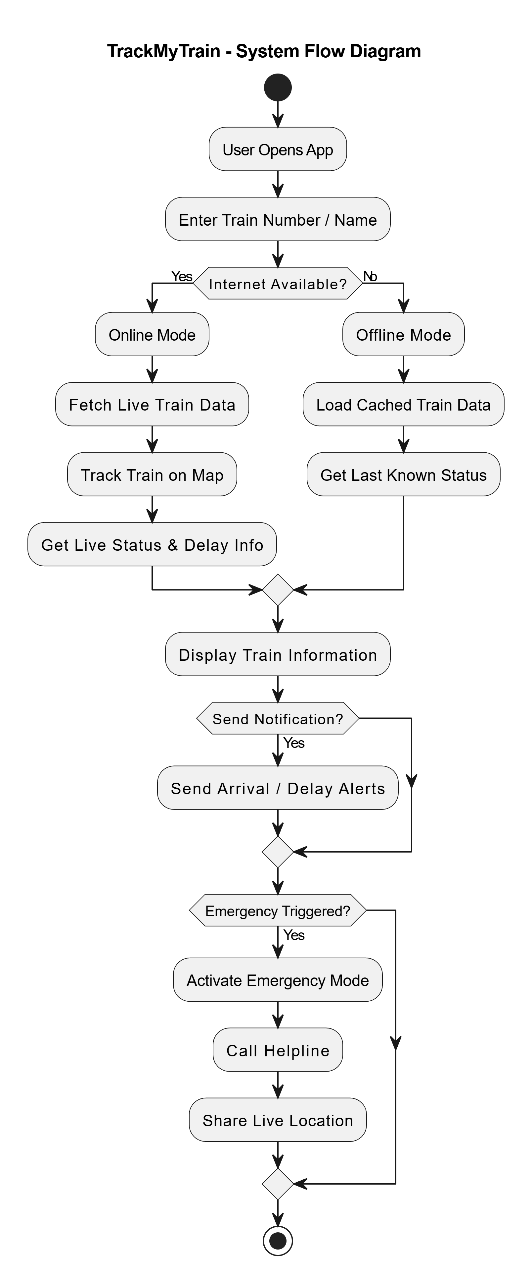
Flow Diagrams

Slide 8
Module Design
Train Information module
live Tracking and map module
User Authentication module
Notification module
Offline Module
Data management Module

Slide 9
Train Information Module
This module provides basic and static train details to users.
It includes train number, name, schedule, route, and station information.
The data helps users understand the complete journey plan.
It is used as the foundation for other modules.

Slide 10
Live Tracking and Map Module
This module tracks the real-time location of the train.
It shows current status, delay, and next station details.
Google Maps is used to display the train visually on the map.
It helps users monitor train movement accurately.

Slide 11
Future Scope
The app can be enhanced with AI-based delay prediction for more accurate arrival times.
Integration with ticket booking and seat availability can be added for full travel support.
Voice assistant support can help users get train updates hands-free.
Multi-language support can make the app usable for more people.

Slide 12
Proposed Tools & Technologies:
Programming Language:
Java / Kotlin (Android), JavaScript (Backend)
Frameworks:
Android SDK, Material Design, Node.js, Express.js, Google Maps SDK
Database:
MongoDB Atlas (Cloud), SQLite / SharedPreferences (Offline)
Software Tools:
Android Studio, Visual Studio Code, Postman

Slide 13
Conclusion
This project provides a smart and reliable solution for tracking trains in real time. It improves passenger experience by offering accurate information, alerts, and offline support. Overall, the app makes train travel safer, easier, and more user-friendly.

Slide 14
Reference
Indian Railways Official Website – Train schedules, routes, and railway information.
https://indianrailways.gov.in
Google Developers Documentation – Google Maps SDK for Android.
https://developers.google.com/maps/documentation/android

